Slide 1
OPTIC FIBRE

Slide 2
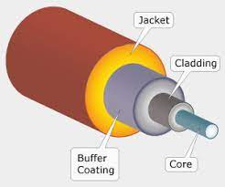

Slide 3
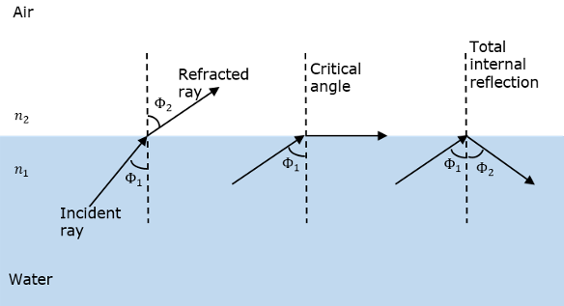
PROPAGATION MECHANISM IN OPTIC FIBRE

Slide 4
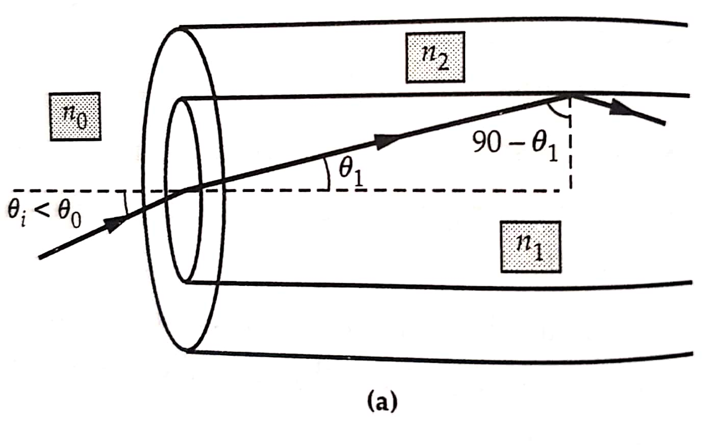

Slide 5
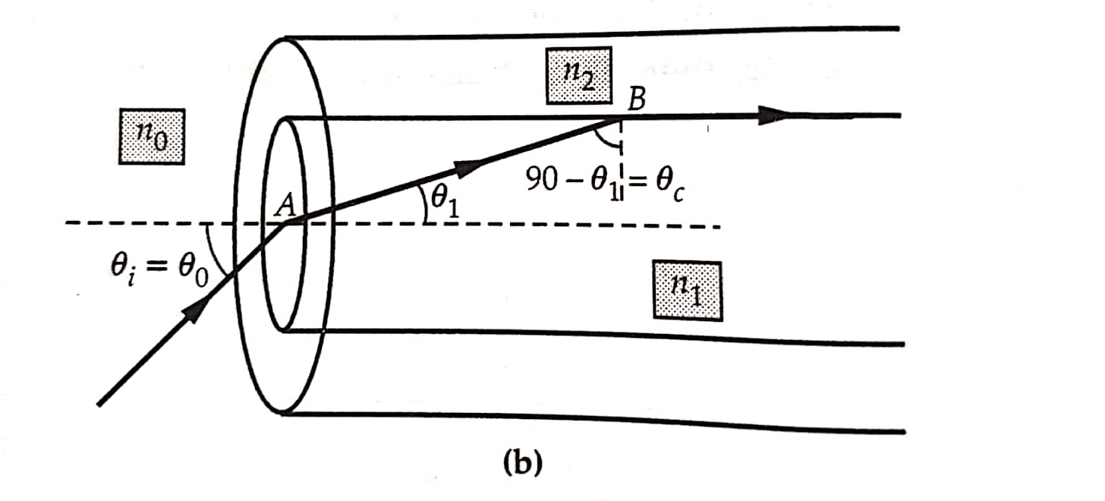

Slide 6
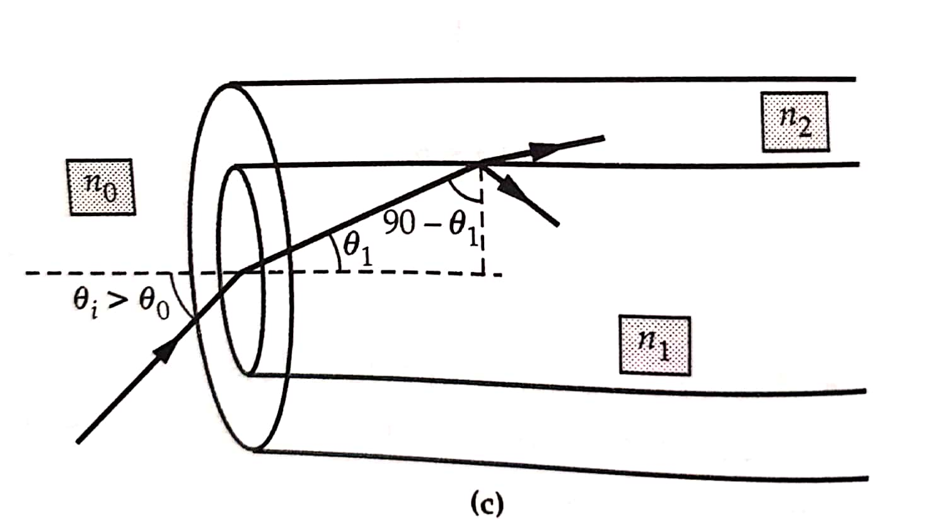

Slide 7
Acceptance Angle:
The angle of incidence θ0 of light on the core for which the angle of incidence on the core cladding interface equals to critical angle is known as angle of acceptance(θ0 )
sinθ0 is numerical aperture.
The maximum angle of Incidence on the core for which total internal reflection takes place inside the core is called Acceptance angle.

Slide 8
Types of Optical Fibres:
Optical fibres are classified according to following criteria:
1.Material used
2.Number of modes
3.Variation of R.I. along diameter

Slide 9
Glass and Plastic Fibres
Glass optic fibres consist of a glass core surrounded by
glass cladding of smaller R.I.
Glass fibres have lower attenuation and larger
mechanical strength compared to plastic fibre.
Material used for glass fibre:Silica(SiO2)
Silica can be doped with aluminium oxide to increase R.I
Silica can be doped with Fluorine to decrease R.I
Silica fibre can be drawn into thinner fibres compared to
plastic ,hence suitable for long distance communication.
Plastic fibre are made up of a core polystyrene and a
cladding of polymethyl methacyclate.
Plastic fibres are more flexible compared to glass fibres.
Plastic fibres have more attenuation and can’t be drawn
into very thin fibres. Hence suitable for short distance.

Slide 10
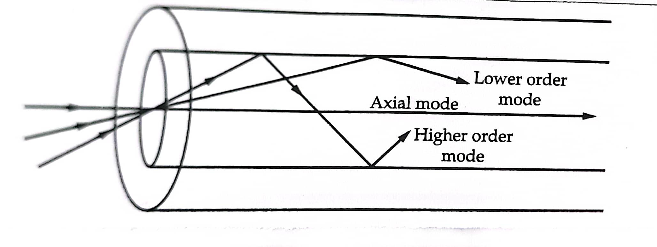
Step index and multimode Fibres:

Slide 11
Step Index fibres
Core of homogeneous medium of R.I μ1 and
cladding of another homogeneous medium of R.I μ2
μ2 < μ1
Due to change in R.I. at the core cladding interface, they are called step index fibres.

Slide 12
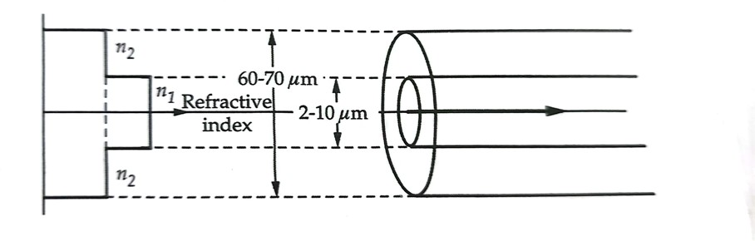
Single mode step index fibre
μ2
μ1
μ2
If the core diameter ,of the order of 2μm to 10 μm. Are known single mode step index fibre .
Due to small diameter of core ,these fibres transmit only axial mode.
The thickness of the core is 25 μm to 30 μm.
These fibres are used for long distance communication.

Slide 13
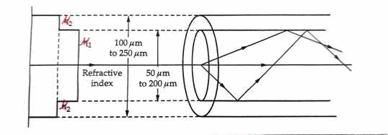
Multimode step index fibre
At core diameter ,of the order of 50μm to 200 μm and cladding thickness20 μm to 25 μm. ,it can transmit a large no. of modes as shown in fig. These fibres known as multimode step index.
These fibres are cheaper compared to other fibres but not suitable for long distance communication.

Slide 14
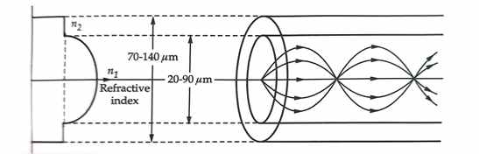
Graded index multimode fibre
μ2
μ1
R.I. is maximum at the axis of the core, decreases gradually
upto cladding and remains constant throughout the cladding.
The ray traveling at an angle to the axis travel in curved path
due to gradually decreasing R.I.
These rays travel longer distance compared to the axial ray.
They travel in region of small R.I.and hence travel faster.
This reduces intermodal dispersion.
The core diameter is typically about 20μm to 100 μm with
cladding thickness of about 25 μm.
They are used for medium distance communication.

Slide 15
Attenuation:
The power loss of optical signals when they travel through optical fibre is known as attenuation.
Attenuation Constant:
The power loss per unit length.
Attenuation in optic fibre is due
to absorption, scattering and
radiation losses

Slide 16
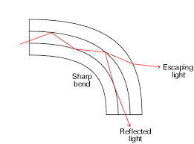
Absorption:
Light can be absorbed either by the pure fibre material which is known as intrinsic absorption or it can be absorbed by impurities present in the core of the fibre.
Scattering:
Light travelling through the core can get scattered by impurities or small region with sudden change in R.I.
Radiation loss
Losses due to change in angle of incidence on the core cladding interfacing due to bending of cable at core cladding interface.
Light is partly lost by refraction due to microscopic bends as angle of incidence becomes smaller than critical angle.
These losses can minimized by bending the cable in large radius of curvature.

Slide 17
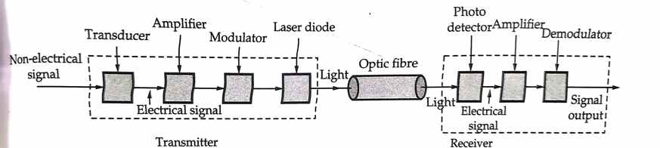
Optic fibre communication system
A non electric signal like sound in telecommunication is
converted into electrical signal by a transducer.
The signal is amplified ,modulated then fed to a laser diode
or LED which converts the signal into a light signal.
Then the transmitter transmit a light signal through optic fibre.
In the receiver,the light signal is converted into electric signal
by an amplfier .
The amplified electric signal is demodulated and fed to speakar
which convert it into sound signal.
In data transfer system,which transfer digital data from one computer to another ,there is no transducer in the transmitter.
The input of transmitter and output of receiver are both electric signal.

